Slide 1
Chapter 4
Mathematical Expectation
Chapter 4
Mathematical Expectation

Slide 2
Chapter 4.1
Mean of a Random Variable
Mean of a Random Variable
If two coins are tossed 16 times and X is the number of heads that occur per toss, then the values of X can be 0, 1, and 2.
Suppose that the experiment yields no heads, one head, and two heads a total of 4, 7, and 5 times, respectively.
The average number of heads per toss of the two coins is then
The value means that on average we can expect that by each toss the head will occur for 1.06 times and no head for 0.94 times.
1.06 is called an expected value, a term used to describe the long-term average outcome of a given scenario.

Slide 3
Chapter 4.1
Mean of a Random Variable
Mean of a Random Variable
Let X be a random variable with probability distribution f(x). The mean or expected value of X is
if X is discrete, and
if X is continuous.

Slide 4
Chapter 4.1
Mean of a Random Variable
Mean of a Random Variable
A lot containing 7 components is sampled by a quality inspector, the lot contains 4 good components and 3 defective components. A sample of 3 is taken by the inspector. Find the expected value of the number of good components in this sample
Let X represent the number of good components in the sample. The probability distribution of X is
Thus, if 3 components are selected at random over and over again from a lot of 4 good components and 3 defective components, one will pick on average 1.7 good components and, accordingly, 1.3 bad components.

Slide 5
Chapter 4.1
Mean of a Random Variable
Mean of a Random Variable
In a gambling game a man is paid $5 if he gets all heads or all tails when three coins are tossed, and he will pay out $3 if either one or two heads show. What is his expected gain?
The sample space for the possible outcomes of this game is
Each of these events is equally likely and occurs with probability of each equal to 1/8.
Let Y be the amount of money the gambler can win, E₁ is the event of winning 5$ and E₂ is event of losing $3,
In this game the gambler will, on average, loss $1 per toss of the three coins.

Slide 6
Chapter 4.1
Mean of a Random Variable
Mean of a Random Variable
A salesperson has two appointments on a given day. He believes that he has 70% chance to make the deal at the first appointment, from which he can earn $1000 commission if successful. On the other hand, he thinks he only has a 40% chance to make the deal at the second appointment, which will give him $1500 if successful.
What is his expected commission based on his own probability belief? Assume that the appointment results are independent of each other.
Let X be the commission the salesperson will earn. Due to independence, the probabilities can be calculated as

Slide 7
Chapter 4.1
Mean of a Random Variable
Mean of a Random Variable
Let X be the random variable that denotes the life in hours of a certain electronic device. The probability density function is
Find the expected life of this type of device.
Therefore, we can expect this type of device to function well for, on average, 200 hours.

Slide 8
Chapter 4.1
Mean of a Random Variable
Mean of a Random Variable
Let X be a random variable with probability distribution f(x). The mean or expected value of the random variable g(X) is
if X is discrete, and
if X is continuous.

Slide 9

Chapter 4.1
Mean of a Random Variable
Mean of a Random Variable
Suppose that the number of cars X that pass through a car wash between 4:00 P.M. and 5:00 P.M. on any sunny Friday has the following probability distribution:
Let g(X) = 2X – 1 represent the amount of money in dollars, paid to the attendant by the manager. Find the attendant’s expected earnings for this particular time period.

Slide 10
Chapter 4.1
Mean of a Random Variable
Mean of a Random Variable
Let X be a random variable with density function
Find the expected value of g(X) = 4X + 3.

Slide 11
Chapter 4.1
Mean of a Random Variable
Mean of a Random Variable
Let X and Y be random variables with joint probability distribution f(x,y). The mean or expected value of the random variable g(X,Y) is
if X and Y are discrete, and
if X and Y are continuous.

Slide 12
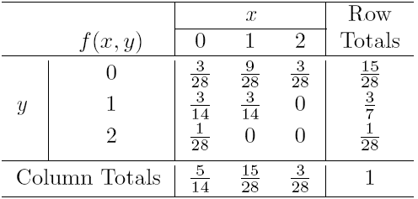
Chapter 4.1
Mean of a Random Variable
Mean of a Random Variable
Let X and Y be a random variables with joint probability density function as in the “ballpoint pens” example. Find the expected value of g(X,Y) = XY

Slide 13
Chapter 4.1
Mean of a Random Variable
Mean of a Random Variable
Find E(Y/X) for the density function

Slide 14
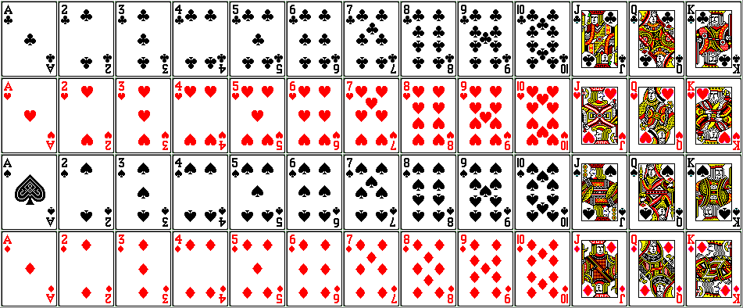
Probability and Statistics
Homework 4A
From a regular deck of 52 playing cards we pick one at random. Let the random variable X equal the number on the card if it is a numbered one (ace counts as 1) and 10 if it is a face card (J, Q, and K). Find E(X).
1
2
3
4
5
6
7
8
9
10
10
10
10
Four indistinguishable balls are distributed randomly into 3 distinguishable boxes. Let X denote the number of balls that end up in the first box. Find E(X). (Sch.E5.1.1-2)

Slide 15
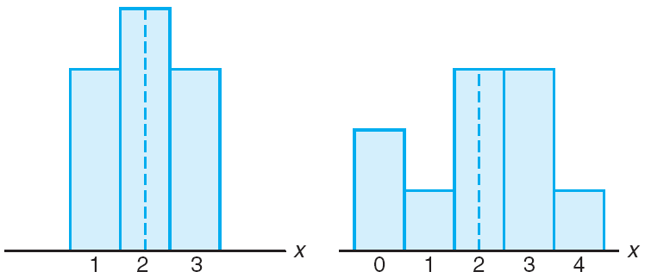
Chapter 4.2
Variance and Covariance
Variance and Covariance
The mean or expected value of a random variable X is important because it describes the center of the probability distribution.
However, the mean does not give adequate description of the shape and variability in the distribution.
Distribution with equal means but different dispersions (variability)
The most important measure of variability of a random variable X is obtained by letting g(X) = (X– μ)².
This variability measure is referred to as the variance of the random variable X or the variance of the probability distribution of X. It is denoted by Var(X) or the symbol , or simply by .

Slide 16
Chapter 4.2
Variance and Covariance
Variance and Covariance
Let X be a random variable with probability distribution f(x) and mean μ. The variance of X is
if X is discrete, and
if X is continuous.
The positive square root of the variance, σ, is called the standard deviation of X.

Slide 17


Chapter 4.2
Variance and Covariance
Variance and Covariance
Company A
Let the random variable X represent the number of cars that are used for official business purposes on any given workday. The probability distribution for company A and company B are
Company B
Show that the variance of the probability distribution for company B is greater than that of company A.
Clearly, the variance of the number of cars that are used for official business purposes is greater for company B than for company A.

Slide 18

Chapter 4.2
Variance and Covariance
Variance and Covariance
The variance of a random variable X is also given by
Let the random variable X represent the number of defective parts for a machine when 3 parts are sampled from a production line and tested. The following is the probability distribution of X
Calculate the variance σ².

Slide 19
Chapter 4.2
Variance and Covariance
Variance and Covariance
The weekly demand for a drinking-water product, in thousands liters, from a local chain of efficiency stores, is a continuous random variable X having the probability density
Find the mean and variance of X.

Slide 20
Chapter 4.2
Variance and Covariance
Variance and Covariance
Let X be a random variable with probability distribution f(x). The variance of the random variable g(X) is
if X is discrete, and
if X is continuous.

Slide 21

Chapter 4.2
Variance and Covariance
Variance and Covariance
Calculate the variance of g(X) = 2X + 3, where X is a random variable with probability distribution given as

Slide 22
Chapter 4.2
Variance and Covariance
Variance and Covariance
Let X be a random variable with density function
Find the variance of the random variable g(X) = 4X + 3 if it is known that the expected value of g(X) = 8.

Slide 23
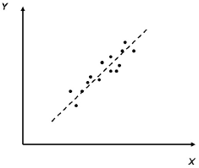
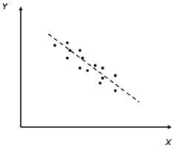
Chapter 4.2
Variance and Covariance
Variance and Covariance
Let X and Y be a random variables with probability distribution f(x, y). The covariance of the random variables X and Y is
if X and Y are discrete, and
if X and Y are continuous.
σ_{XY} >0,
Positive correlation
σ_{XY} <0
Negative correlation

Slide 24
Chapter 4.2
Variance and Covariance
Variance and Covariance
The covariance of two random variables X and Y with means μ_{X} and μ_{Y}, respectively, is given by

Slide 25
Chapter 4.2
Variance and Covariance
Variance and Covariance
Referring back again to the “ballpoint pens” example, find the covariance of X and Y.
See again Lecture 4

Slide 26
Chapter 4.2
Variance and Covariance
Variance and Covariance
The fraction X of male runners and the fraction Y of female runners who compete in marathon races is described by the joint density function
Find the covariance of X and Y

Slide 27
Chapter 4.2
Variance and Covariance
Variance and Covariance
Although the covariance between two random variables does provide information regarding the nature of the relationship, the magnitude of σ_{XY} does not indicate anything regarding the strength of the relationship, since σ_{XY} is not scale free.
This means, that its magnitude will depend on the units measured for both X and Y.
There is a scale-free version of the covariance called the correlation coefficient, that is used widely in statistics.
Let X and Y be random variables with covariance σ_{XY} and standard deviation σ_{X} and σ_{Y}, respectively. The correlation coefficient X and Y is

